Slide 1
Purpose and Credo for AccelRR8 Consortium NonProfit
Rich Reba, President
August 6, 2026

Slide 2
Consortium Ambition
Who we are
Technology Services Industry Consortium
Founded in December 2023
Non-Profit Organization registered in Maryland
Rich Reba, President, is a former Fortune 200 C-suite Executive and Tech Consulting GM with current certifications (AI, Agile, CPO, etc.)
Licensed to use Rich Reba’s personal AccelRR8 brand, owned by AccelRR8 LLC
AccelRR8 LLC, a for-profit company, is not an affiliate. It is a patron whose employees and associates are participants in the consortium
Asset-light with very low overhead costs
What we want
Mission is to help enterprising Tech Services industry leaders harness proven accelerators to grow value exponentially at scale
Purpose is helping Tech Services industry leaders work together to accelerate success for themselves, their industry, and all humanity
Vision is Tech Services industry leaders everywhere enjoying exponential success in their industry while helping humanity live increasingly better lives
Ambition is to be the consortium that Tech Services industry leaders credit with generating exponential improvements in industry effectiveness and impact

Slide 3
Consortium Values
Helping Humanity | Making a meaningful contribution to our local and global communities
Delighting Customers | Exceeding our subscribers’ and patrons’ expectations and making them happy
Supporting Colleagues | Empathizing with and respecting those who help us in our job, career, and vocations
Accelerating Success | Harnessing proven accelerators to continuously innovate, collaborate, ideate, learn, use AI, and grow value exponentially (we “drink our own champagne”)
Being Trustworthy | Demonstrating ethical, legal, financial, social, and environmental responsibility

Slide 4
Working with AccelRR8 LLC
BEING TRUSTWORTHY means we are transparent about our ethical relationship with AccelRR8 LLC
AccelRR8 LLC is an independent for-profit business that is not an affiliate of the AccelRR8 Consortium Non-Profit
AccelRR8 LLC is a patron whose employees and associates are collaborators in the AccelRR8 Consortium Non-Profit
AccelRR8 LLC has granted an unlimited use license of the AccelRR8 Brand to the AccelRR8 Consortium Non-Profit in perpetuity without expiration
AccelRR8 LLC owns the AccelRR8 brand and its associated assets, including but not limited to logos, designs, tag lines, and templates
AccelRR8 LLC markets the AccelRR8 brand as Rich Reba’s personal brand
As the AccelRR8 Consortium Non-Profit succeeds, it will create demand for Non-Profit and For-Profit services
Leaders who want to grow value exponentially themselves (“DIY”) can avail themselves of the Non-Profit’s services
Leaders who want additional help growing value exponentially can get it from For-Profit businesses such as AccelRR8 LLC
In the early days, if AccelRR8 LLC is seeing increased demand, it will indicate the Non-Profit is creating value for leaders because they are willing to pay to get help growing value exponentially
The AccelRR8 Consortium Non-Profit will continuously evaluate its strategy as it succeeds, for example:
It may acquire AccelRR8 LLC and operate similarly to OpenAI, where the non-profit owns the for-profit
It may maintain a symbiotic but independent relationship with AccelRR8 LLC similarly to SAP and the ASUG non-profit
It may re-brand, in which case AccelRR8 LLC will hopefully remain one of many patrons

Slide 5
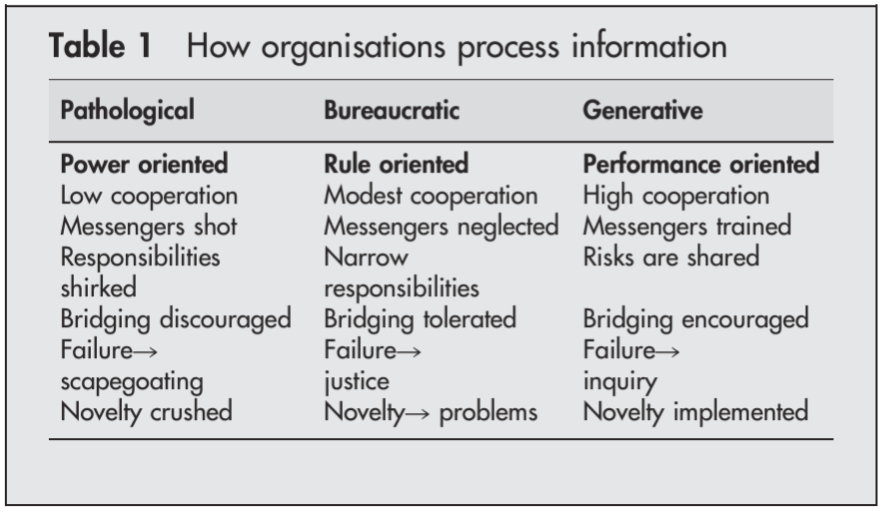
Consortium Culture
Our consortium aspires to a Generative Culture as introduced by Westrum in https://www.ncbi.nlm.nih.gov/pmc/articles/PMC1765804/pdf/v013p0ii22.pdf
Characteristics of our culture:
Performance oriented (not power oriented)
High cooperation (not low)
Messengers are trained (not shot)
Risks are shared (not shirked)
Bridging is encouraged (not discouraged)
Failure leads to inquiry (not scapegoating)
Novelty is implemented (not crushed)
Implies:
Diversity is welcome (not unwelcome)
Environment is safe (not hostile)
People are nice (not a-holes)

